Slide 1
HONEYNETS & HONEYPOTS
Amna Khdair
Hala Abdul jalil

Slide 2
Contents
What's the HoneyPots?
01
02
What’s the HoneyNets?
History about Them
03
04
How do they work?
Their types and classifications
05

Slide 3
Contents
Tools and Services
06
07
Honeynet with Law
Advantage & Disadvantage
08
09
Conclusion

Slide 4
01
What's the HoneyPots?

Slide 5

When you are exposed to any attack in your daily life, what are the methods that come to your mind to defend and repel this attack?

Slide 6
What's the HoneyNets?
02

Slide 7

honeynet is a bunch of honeypots
look and behave like real systems or network services

Slide 8
03
History about Them

Slide 9


“Those who do not consider the mistakes of the past are doomed to repeat them again.”
- Alfred Whitney Griswold

Slide 10
Bill Cheswick noticed an intruder on one of his machines
The narratives of Cliff Stoll and the Cuckoo's Egg.

Slide 11
The Emergence of the Deception Kit by Fred Cohen (1998).
A new group that called themselves the Honeynet Project Founded by former Army tank officer Lance Spitzner.

Slide 12

Honeynet Project shared its knowledge and software tools for deception for several government agencies, the military, and the commercial sector.
Today in the field of information security, deception has become one of the hot new topics.

Slide 13
How Do They Work?
04

Slide 14
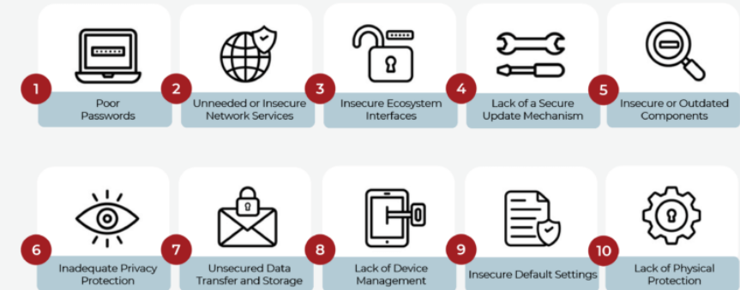
Honeypot
By building in deliberate security vulnerabilities.

Slide 15
Honeypot Way
01
02
Vulnerable ports might be attract attackers
honeypot might have ports that respond to a port scan or weak passwords

Slide 16
03
04
05
Isn't a solution to a problem
Help you understand existing threats
Finally, security efforts can be prioritized and focused.

Slide 17
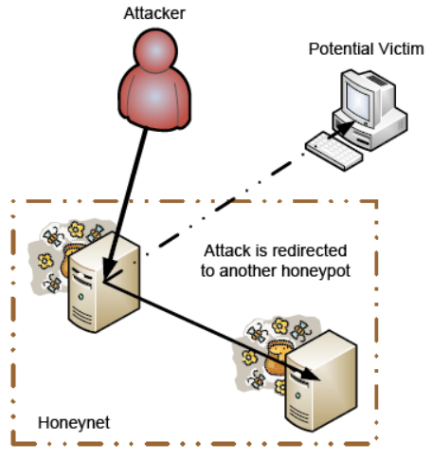
Honeynet
Once the attacker on the honeynet, more honeypots can be used to collect data him.
The honeypots will gather , network traffic, IP addresses, zero-day exploits, all of them improve your network security

Slide 18

Contain:
various OS.
servers.
multiple honeypot instances.
Techniques and Procedures (TTPs).
Indicator of Attacks (IoA).

Slide 19
05
Their types and classifications

Slide 20
Honeypot:
Interaction:
Emulate OS and application side, which is a complex process.
High:
Gives extensive details about attacks and how execute in a network.
Imitate the application side, but don’t have their own OS.
Medium:
Used to stall attackers to give them time to respond to attacks.
LOW:
run limited emulated services with restricted functionality
Early detection mechanism.

Slide 21
Other Types:
Malware
Database
Spider
Client
Email

Slide 22
Tools and Services
06

Slide 23
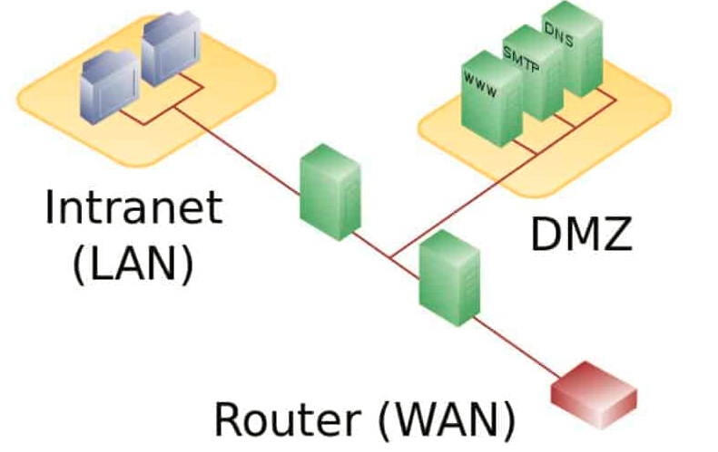
Steps Setting Honeypot
Install the honeypot software
Configure the honeypot
01
03
Configure firewall and logging policies
Testing
02
04

Slide 24
Tools
verify the integrity of system binaries and inform the operator of changes.
Detect compromised POSIX (Unix) system HoneyPots.
Tripwire
INTACT
INTEGRIT
SAMHAIN
Detects changes in systems in real time
Detection system that uses cryptographic checksums of files to detect modifications.

Slide 25
07
Honeynet with Law

Slide 26

There is no single source confirming how many its legitimacy.
Dependent on many variables.
The legal processes in each country are different as they relate to information security, collection, and honeypot technologies.

Slide 27
Liability implies, if your honeypot is used to harm others.
The exemption under Service Provider Protection is key.
The US, for example, have a privacy law, limit the honeypot.
If used to attack other systems or resources, the owners of those may sue.

Slide 28
Advantages & Disadvantages
08

Slide 29


Track the attacker’s moves.
Early warning system.
The ability to study the behaviour of attackers.
The ability to distract and mislead attackers.
Not easy to set up and configure and it .
can attract more attacks than would otherwise occur.
If not configured correctly, can themselves be exploited, which provides a back door into your network.

Slide 30
09
Conclusion

Slide 31
Honeypot and Honeynet, used to attract the attackers to study them behavior.

Slide 32
Honeypot located on one host, but Honeynet consider as a network of honeypot.
As everything on this life, they have adv & disadv, depending on your need used

Slide 33

Was With you Amna Khdair, Hala Abduljalil,
Thank you for listening.

Slide 34
Do have Any Questions ?

